Slide 1
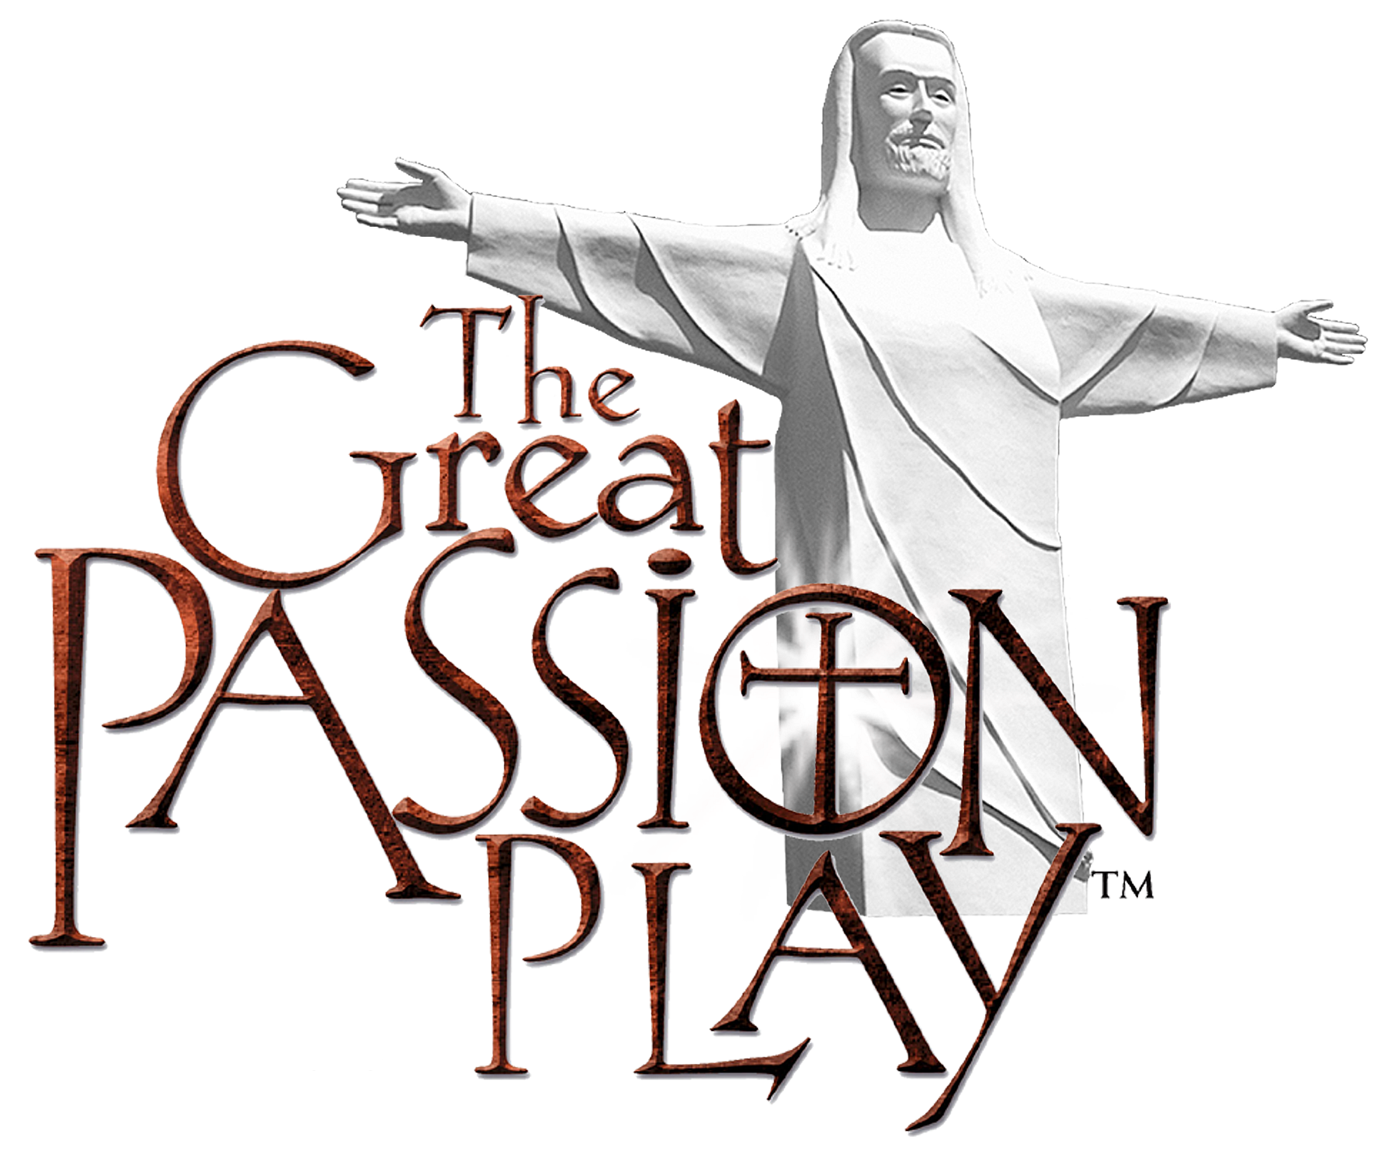

Slide 2
Summary of Projects
2013: Reopening of the complete Holy Land Tour and putting new roofs on the set
2014: Team Effort Mission Trips started
2015: intense Passion Play Set restoration process
2016: Marketplace development & Christ of the Ozarks Restoration in 2016
2017: Hosted summer mission trips started & opening of Noah’s Ark Park Petting Zoo
2018: Arkansas middle and high school mountain biking race with over 18 miles of Biblically themed trails built
2019: First Good Friday & Saturday performances started & The Cross Prayer & Reflection Area

Slide 3
Development of Mission Trips
Groups get to work during the day and then be extras in the Play at night
Over 1,000 volunteers have worked on the property since 2013.
Dorm rooms to accommodate 18 men and 18 women with groups coming from Mississippi, Louisiana, Nebraska, Arkansas, Missouri, Oklahoma, Tennessee, New Mexico so far
Meals are served in our buffet restaurant
Many churches have started to come several years in a row.

Slide 4
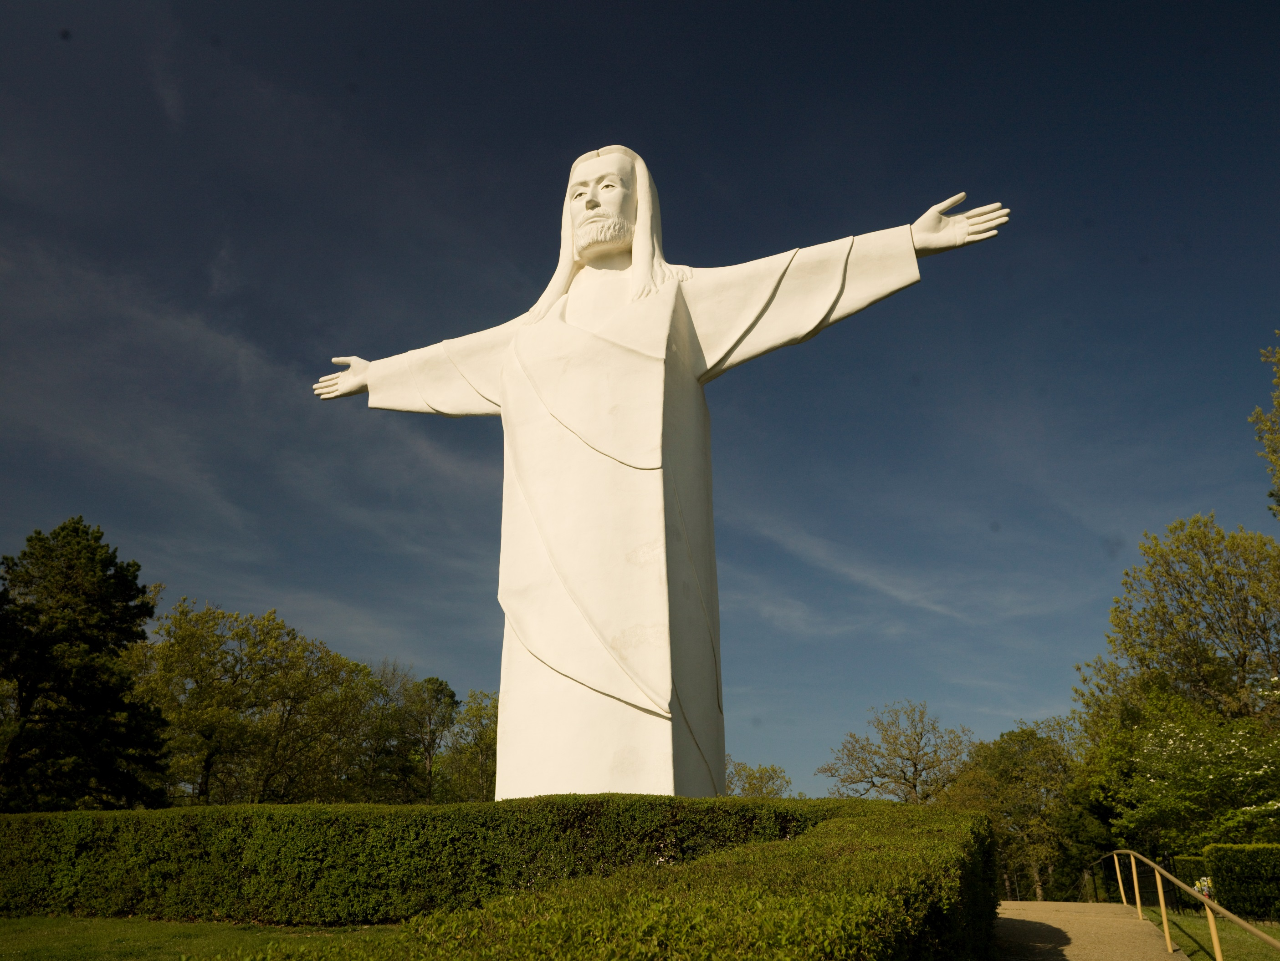

Slide 5
Christ of the Ozarks Restored
Resurfaced and restored in 2016 in time for its 50-year anniversary
Primed and painted with around 100 gallons of paint
Volunteer painter: Rod White (who has helped with painting projects that together are over 300 gallons of paint since 2013)

Slide 6
Passion Play Progress
New special and sound effects added from the Gospels
Reduced the time of the play from 2 hours to 1 hour and 45 minutes without taking out any parts of the story to help with pacing and flow
2 spotlights added with the help of Tom O’Hern & Dover Christian Church
2nd most powerful spotlight in the world that’s been used on broadway

Slide 7
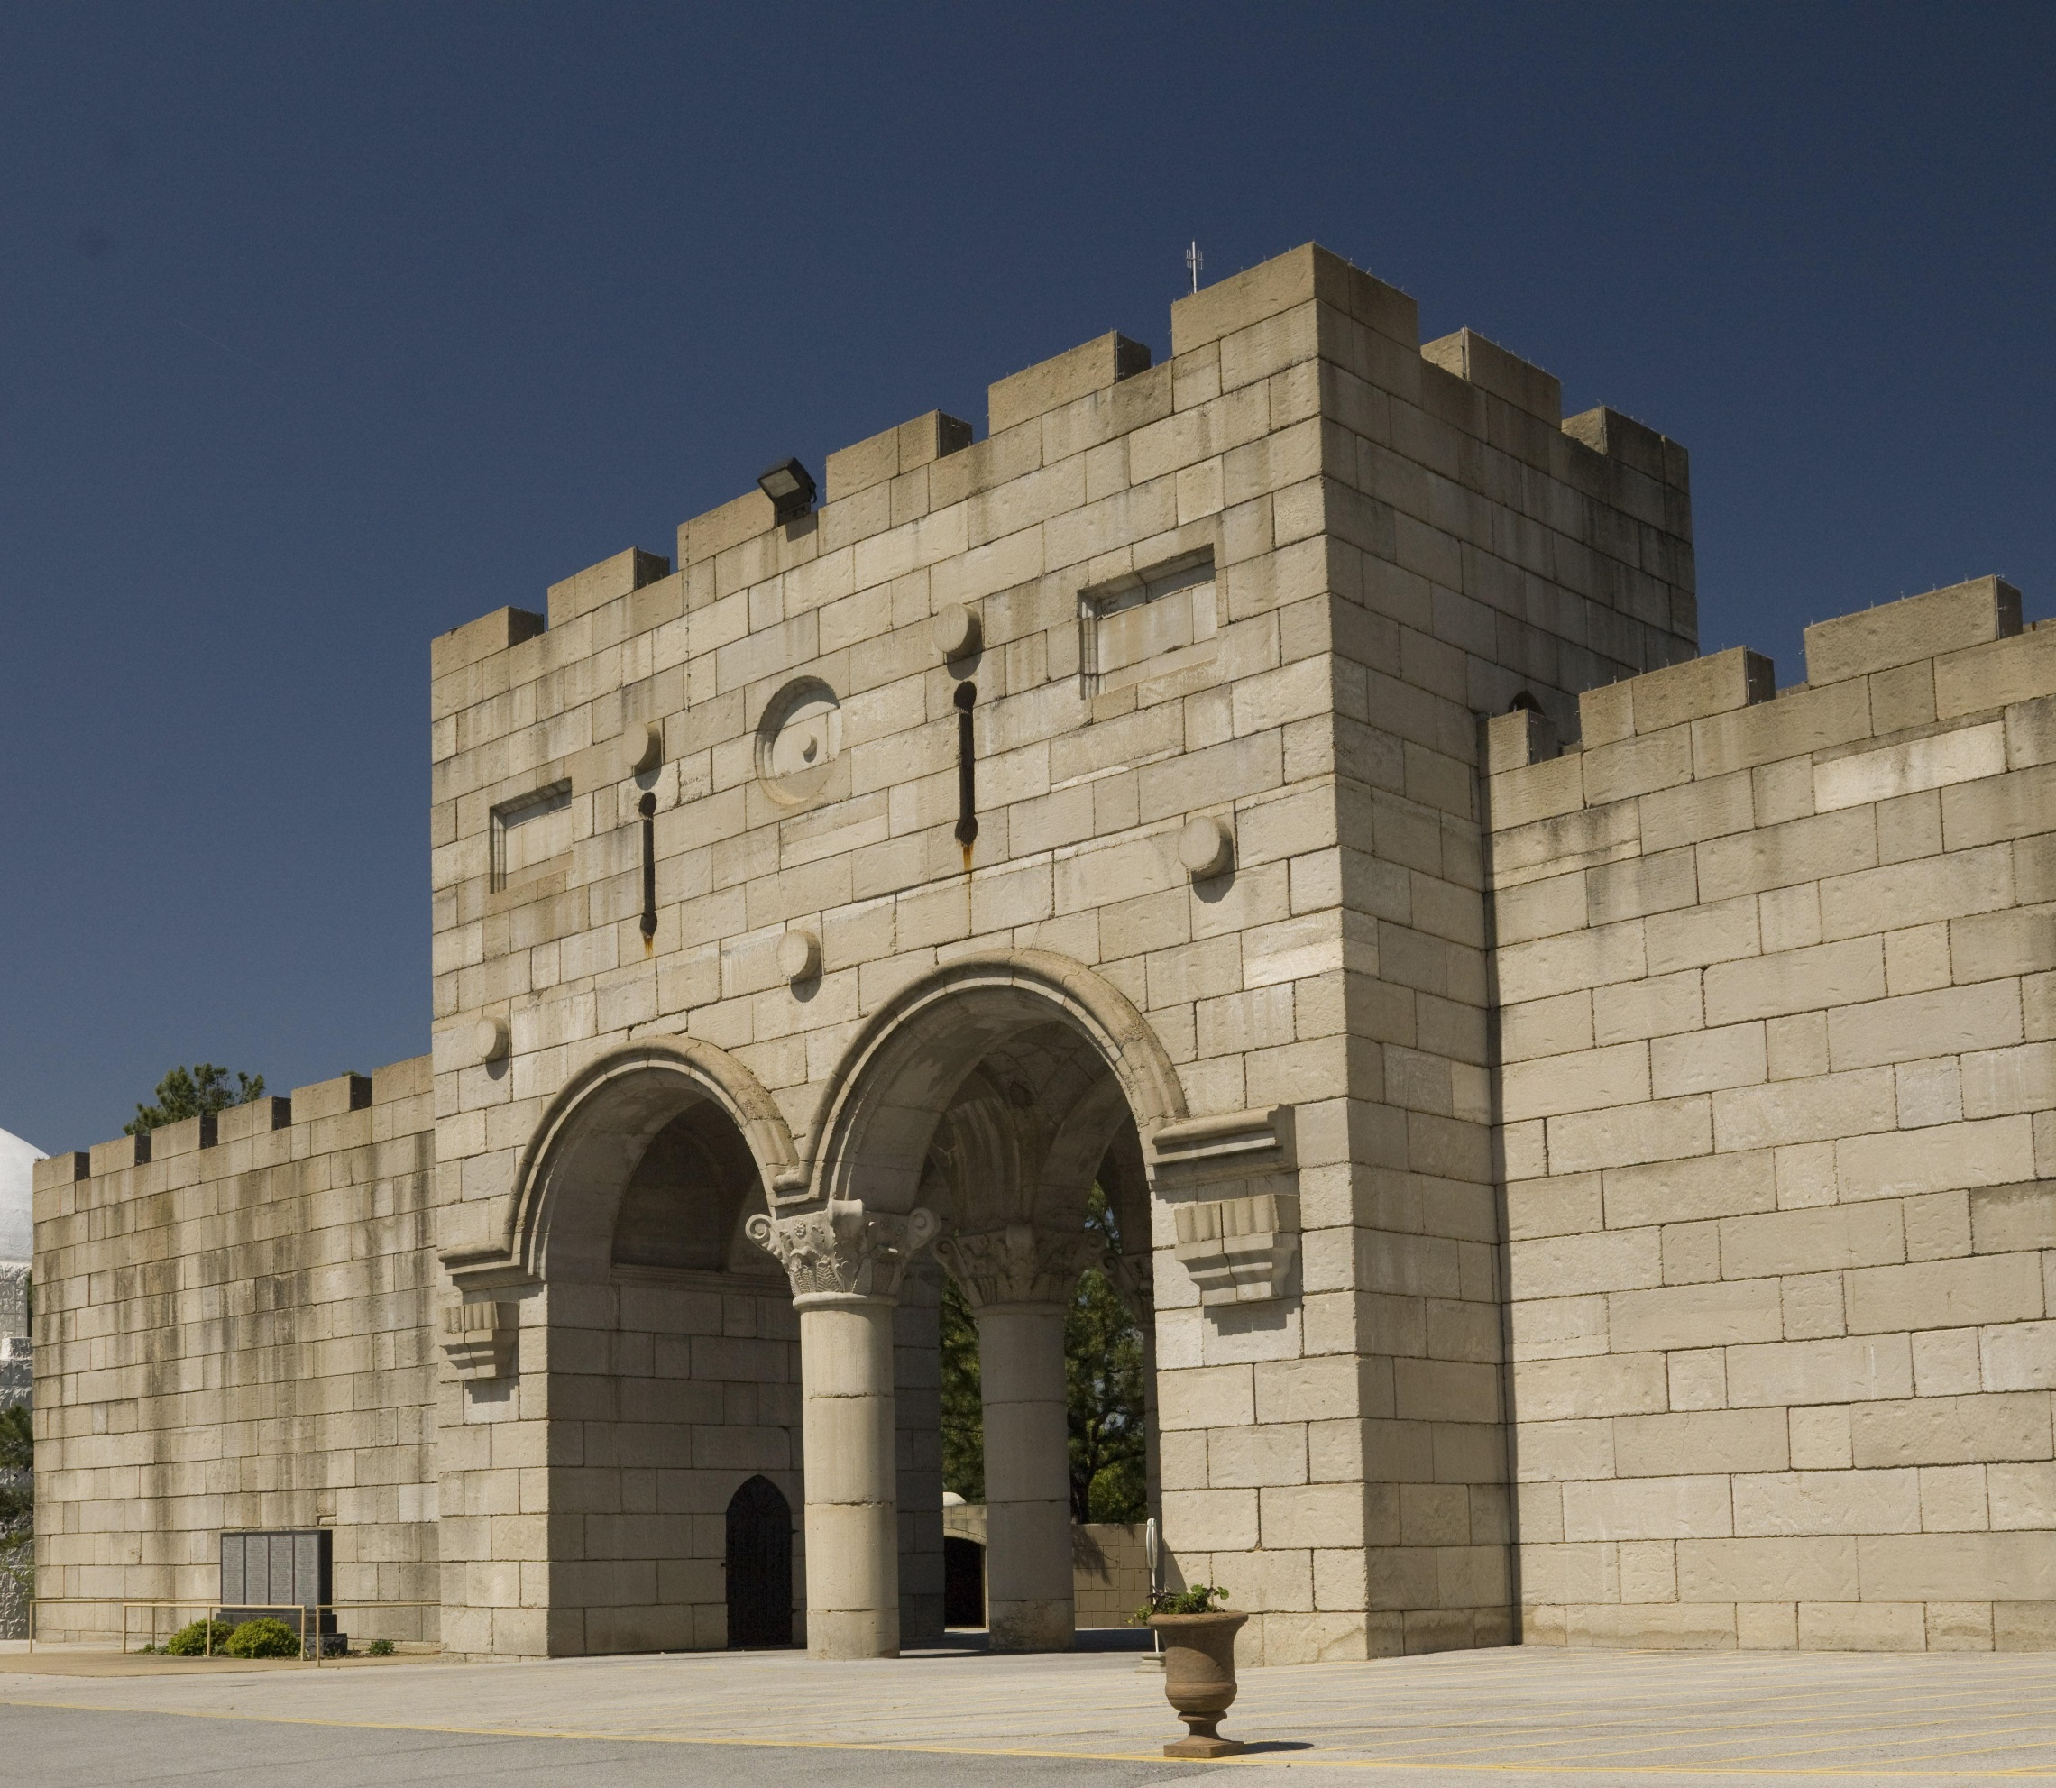

Slide 8
Holy Land Tour Progress
Entire Holy Land Tour reopened down to Bethlehem, the Sea of Galilee, the Upper Room and Tomb area
Re-roofed Bethlehem and Upper Room with volunteers
Built Noah’s Ark Park Petting at the beginning of the Holy Land Tour area especially for kids
Construction Lead James Dean completed the marketplace area where the Potter, David the Shepherd, and the Sculptor are now performed

Slide 9
Tabernacle Progress

Slide 10
Donor Sponsored Projects

Slide 11
Almost 20 miles of Mountain Bike & Hiking Trails—Biblically Themed
Walton Family gave about $1 million to do it.

Slide 12
Christ of the Ozarks BEFORE

Slide 13
Christ of the Ozarks In Progress

Slide 14
Christ of the Ozarks AFTER Christmas lights from Thanksgiving thru New Year’s

Slide 15
Set Before

Slide 16
Set AFTER

Slide 17
Marketplace Before

Slide 18
Marketplace AFTER

Slide 19
Box Office Before

Slide 20
Box Office AFTER

Slide 21
Gardens Before

Slide 22
Gardens AFTER

